Slide 1
BillTech SE-VCP
Software Roadmap

Slide 2
Introduction
BillTech SE-VCP core follows the strategy: setup axis=> acquire => visualise.
Axis can be setup from a variety of sources including USB, bluetooth, OPC-UA, ethernet, etc.

Slide 3
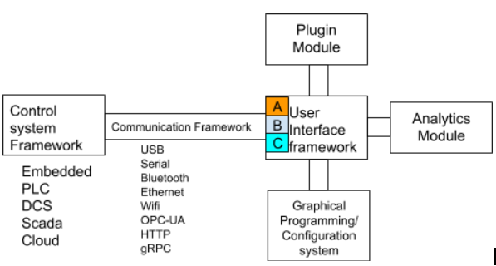
Key features
Remote/data acquisition
Data charts visualisation
Graphical configuration/reprogramming
Ability to have add on features to a core
Consistent user interface across desktop/web/mobile
DCS/Scada enabled
Data analytics

Slide 4
Core epic features
Add Axis/channel to SE-VCP
Change Chart type for Axis channel
Change comm protocol for Axis channel
Acquire Data from module into vcp buffer
Display data from vcp buffer
Display data from data exchange
**View Device/Axis status

Slide 5
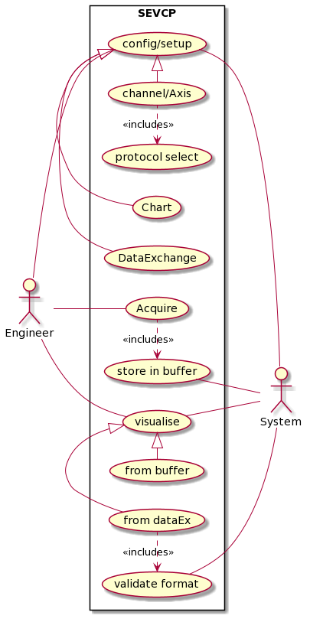
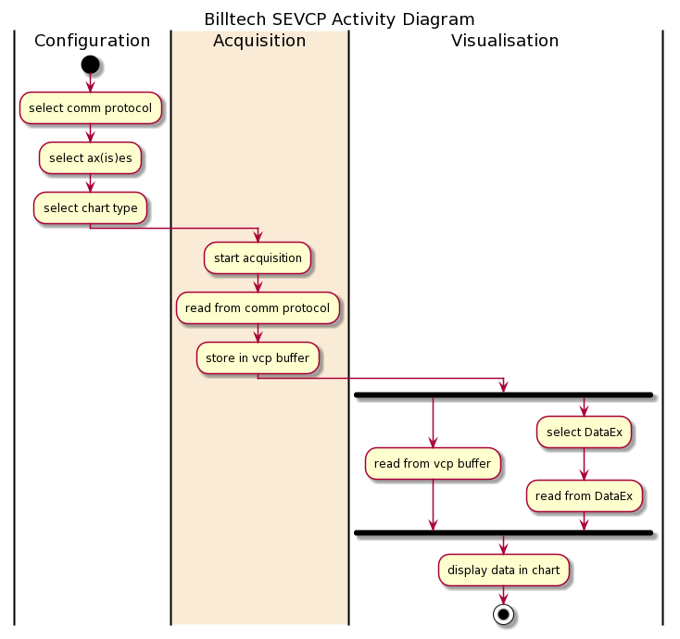
Core epic module use case and tasks

Slide 6
Screens and wireframe**
Home
Configure
Device/Channel
Data-Exchange
Visualise

Slide 7
Project Tasks
UI Design
Wireframe design
Layout design
Screen design
Front End Development
Layout
Screen Components
Component functionality
Chart function
BackEnd Development
System modules
Communication module
Configuration module
Acquisition module
Data Exchange and interface Definition
Data modelling, design and implementation

